Slide 1


Defend penguins
劉承順
Course Project for 3D Game Programming
Instructor: Sai-Keung Wong
NCTU,
2018/01/15

Slide 2
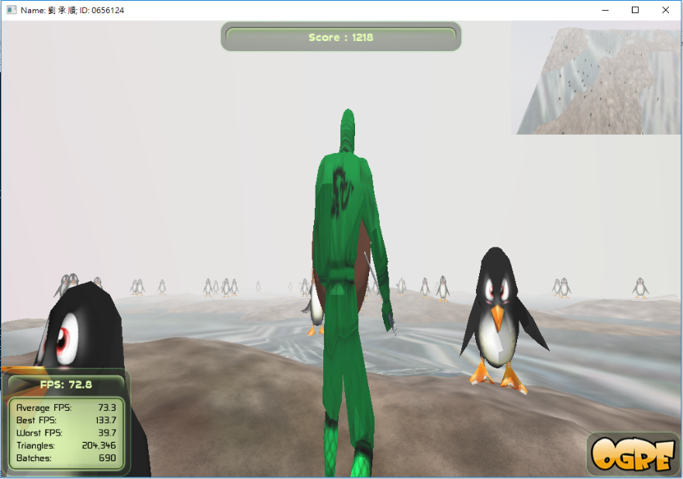
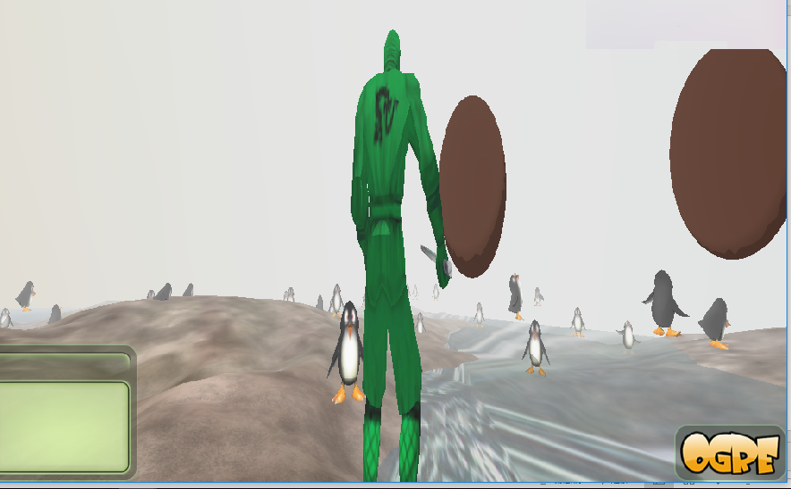
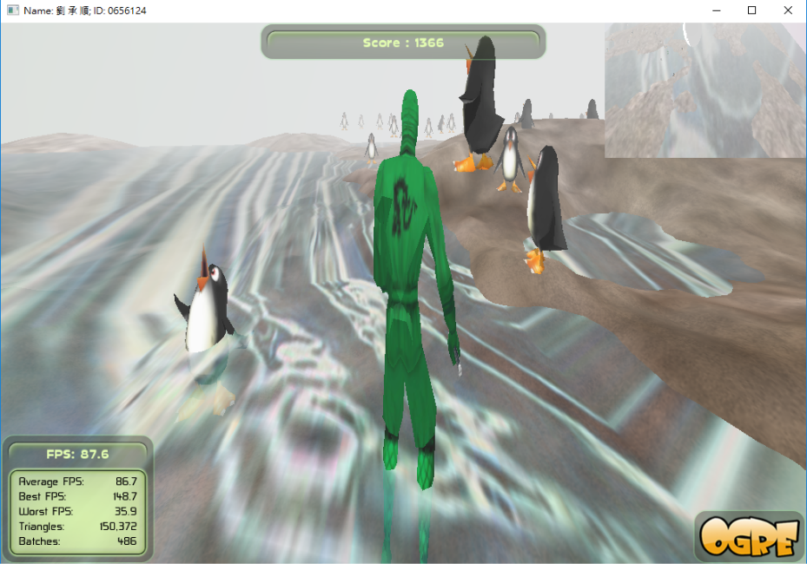
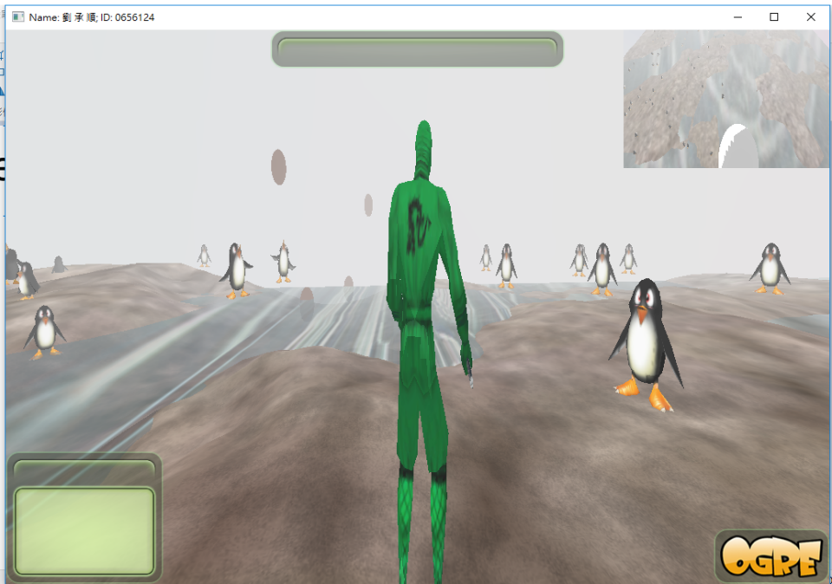
Representative images (at least 4)

Slide 3
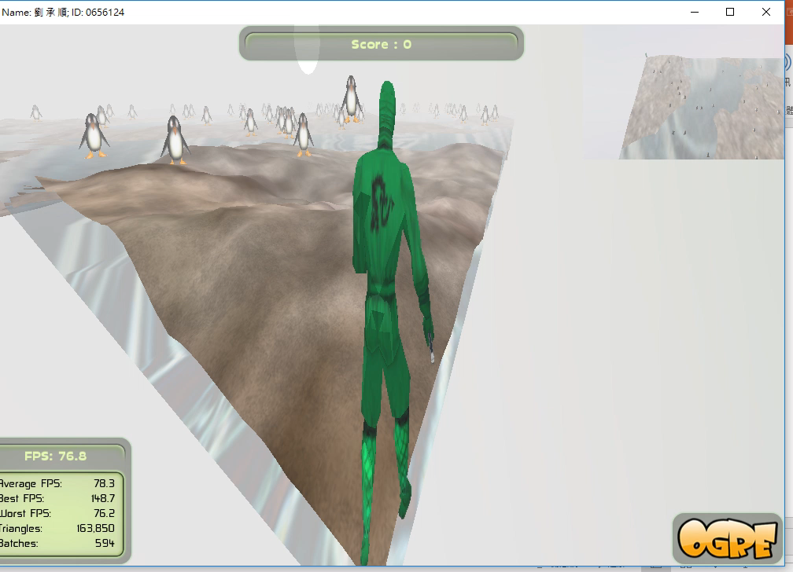
Play a demo movie (~1 minute)

Slide 4
Content
Game Design
System Architecture
Techniques
Implementation items
Member Contribution List
Task List with milestones
Demo
Conclusion

Slide 5
Game Design
Game Features
Game Story
Game Goal
Game Control
Levels

Slide 6
Game Design - Game features
A 3D shooting game.
Penguins chasing you, attack them and
prepare their rush!

Slide 7
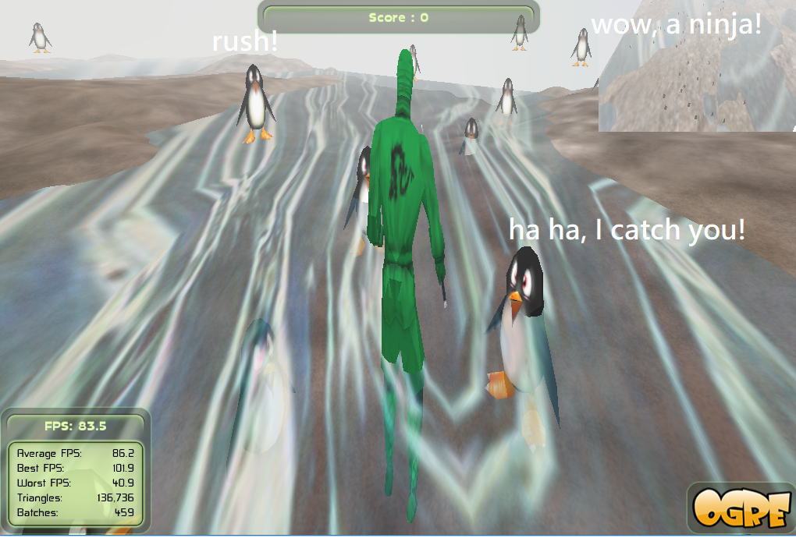
Game Design - Game story
A ninja, comes to the
Penguin island.
The weather is too
hot, so penguins are
Angry.
He wants to defend
Angry penguins.

Slide 8
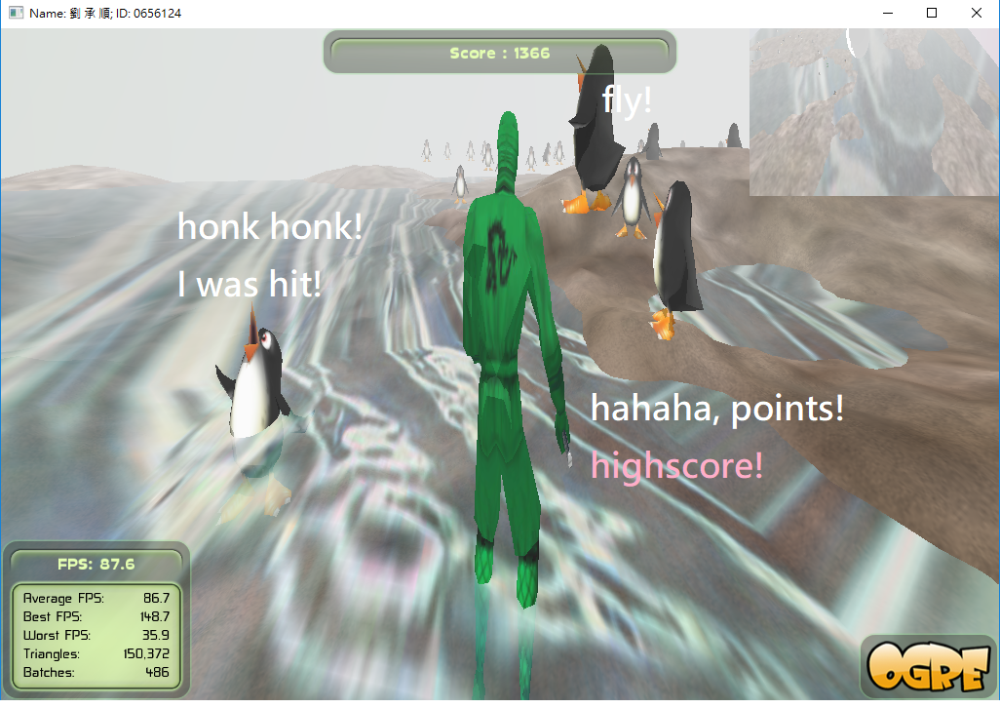
Game Design - Game goal

Slide 9
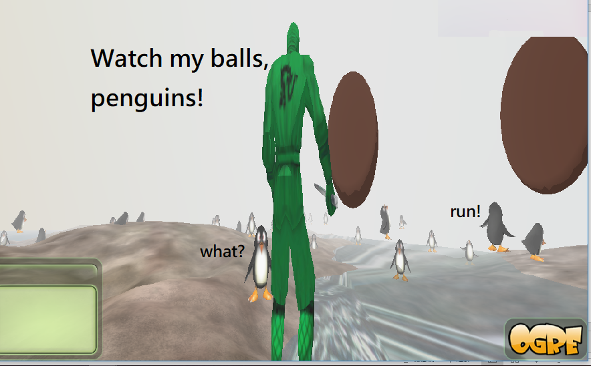
Game Design - Game control
W: go forward
S: go backward
Spacebar: shoot big ball
Mouse: change direction

Slide 10

Game Design – Game level(s)
If you hit a penguin, you get 100 point.
If you hit a shocked penguin,
you get only 3 point.
Try as much point as you can!

Slide 11
System architecture
Defend penguins
main function -TutorialApplication.cpp
Main character -main_char.cpp
Attack -weapon_manager.cpp
CreateScene
Framestarted
Key pressed/released
Mouse move
monsters.cpp
weapons.cpp
Other basic functions
collision_detection.cpp
game_obj.cpp
read_data.cpp
View
Monsters -monster_manager.cpp
animations
Walk

Slide 12
Technical section
Ninja animation, penguin animation
1. Ninja animation: walk, idle, attack
if (mWeaponMgr->mCoolDownTimeForFiring < 0.2){
mAnimationState = mEntity->getAnimationState("Kick");
mAnimationState->setLoop(true);
mAnimationState->setEnabled(true);
mAnimationState->addTime(5*evt.timeSinceLastFrame*sf);
}

Slide 13
Technical section
2. penguin animation
if (hit){
mMonsterMgr->mMonstersArr[j]->die= true;
}
void MONSTER::update(const Ogre::FrameEvent& evt)
{
if (die){
dieTime = dieTime + evt.timeSinceLastEvent;
mAnimationState = mEntity->getAnimationState("amuse");
mAnimationState->setLoop(true);
mAnimationState->setEnabled(true);
mAnimationState->addTime(2*evt.timeSinceLastFrame);
if (dieTime >= 5){
dieTime=0;
die = false;
mAnimationState->setEnabled(false);
}
return;
}
….
}

Slide 14
Physics
Collision detect
penguins
Balls(bullet)
Ninja
penguins
Balls(bullet)
Big sphere
penguins

Slide 15
Physics
Gravity
Balls have gravity and a little air resistence.
Terrain
The ninja walks on the main terrain.

Slide 16
Contributions & Implementation items
All the items that are implemented by each member
me: idea, find information, coding, debug.
Contribution ratios
100% me.
Work hours of each member
about 20 hours for me.

Slide 17
Milestones & Schedule
All the completed items and records with date
106/10/22 proposal finished.
107/1/13 idea decided, environment prepared.
107/1/14 implemented third-person vision, ninja animation.
107/1/15 penguin animation, debug, video.
The member names
game creator: 劉承順

Slide 18
Online Demo
Run your program
Run through your game

Slide 19
Conclusion
Ogre 3D is a 3D engine, but not a very convenient game engine. So I create a game based on the template of course homeworks.
It is a 3D game, we can explore the world by controlling the ninja.
My game have character animations, making them looked natural. The ninja fights the penguins, hope you enjoy the game, and get high score.
Thanks for listening!

